Slide 1
Carnegie Mellon
Computer Systems Organization
https://nyu-cso.github.io
Jinyang Li

Slide 2
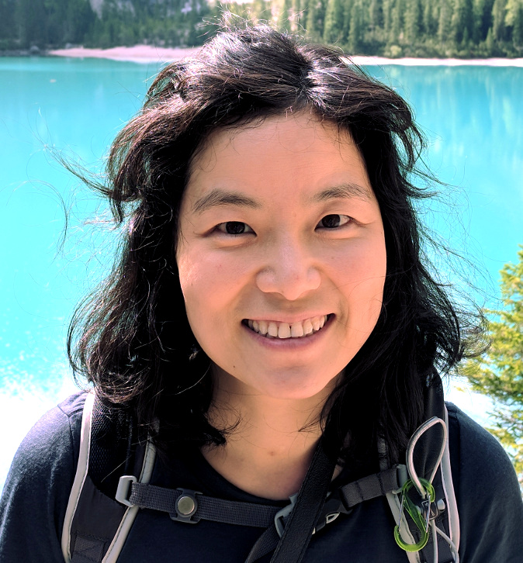

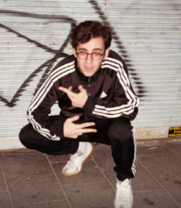
Carnegie Mellon
Course staff
Lecturer: Prof. Jinyang Li
Research: distributed systems
Recitation instructor:
John Westhoff (2nd PhD student)
Research: distributed systems
TA:
Itamar Reif (senior)
Past CSO survivor

Slide 3


Important notice
We are experimenting with a new curriculum!
How this affects you:
This class is different from other CSO sections
This class prepares you for “Operating Systems” (Spring 2020) taught by Prof. Aurojit Panda
CSO
OS
CS majors: Register for Prof. Panda’s OS in the spring!!

Slide 4
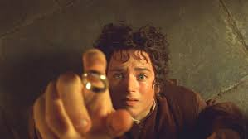
Course Goal
How does a computer really work?
How does the ring really work?

Slide 5
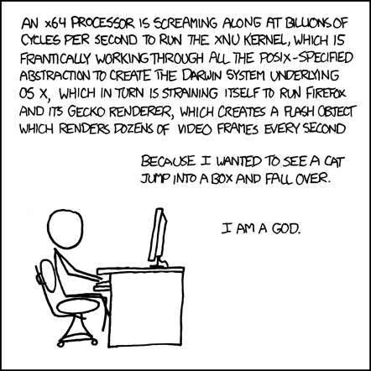

Slide 6
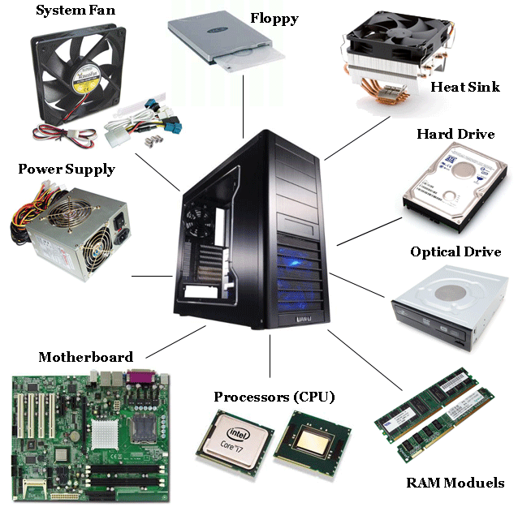
Components of a computer: hardware

Slide 7
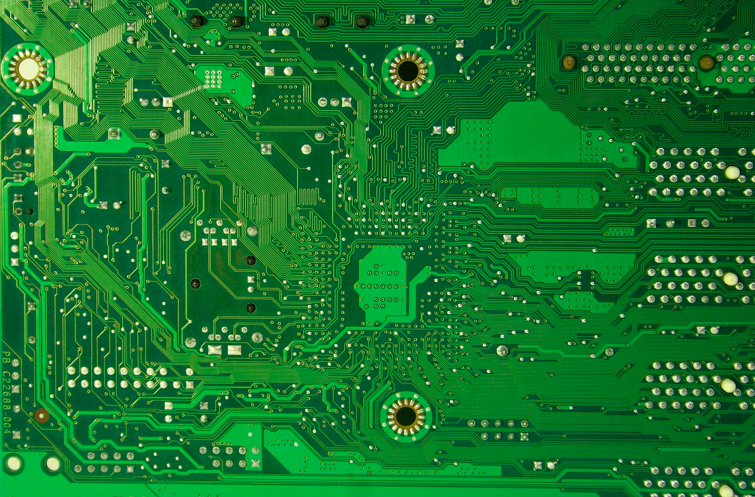

Components of a computer: hardware
Printed Circuit

Slide 8

Components of a computer: hardware + software
Printed Circuit

Slide 9
Layered Organization
Software
Hardware

Slide 10
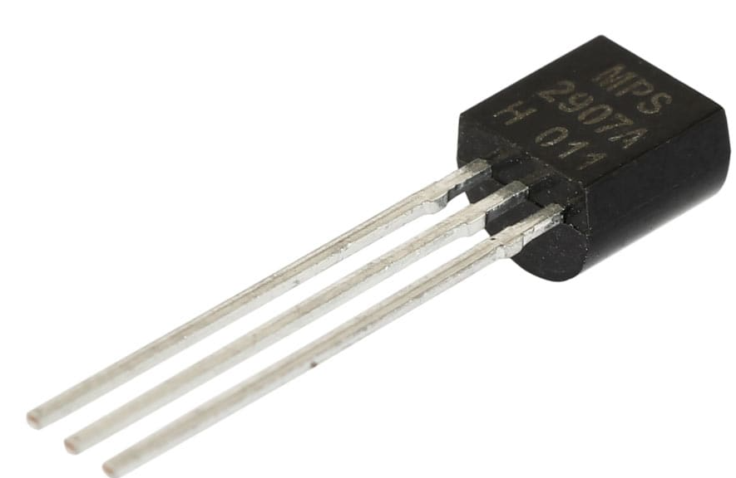
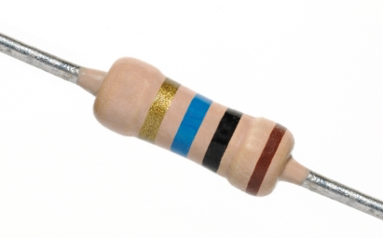
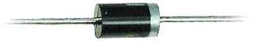
Layered Organization
Software
Hardware
Transistors
Diodes
Resistors

Slide 11
Layered Organization
Software
Hardware
Logical Circuits,
Flip-Flops, Gates
Transistors
Diodes
Resistors

Slide 12
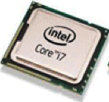
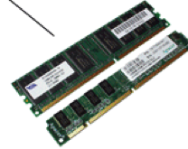
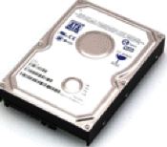
Layered Organization
Software
Hardware
CPU, Memory, Disk
Logical Circuits,
Flip-Flops, Gates
Transistors
Diodes
Resistors

Slide 13
Layered Organization
Software
Hardware
CPU
Memory
I/O
Logical Circuits, Flip-Flops, Gates, …
Transistors, Diodes, Resistors, …

Slide 14






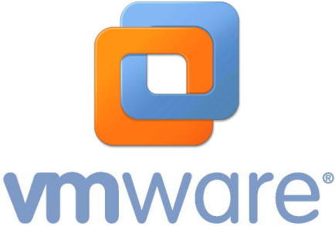
Layered Organization
System Software
(OS, compiler, VM…)
Software
Hardware
CPU
Memory
I/O
Logical Circuits, Flip-Flops, Gates, …
Transistors, Diodes, Resistors, …

Slide 15






Layered Organization
User Applications
System Software
(OS, compiler, VM…)
Software
Hardware
CPU
Memory
I/O
Logical Circuits, Flip-Flops, Gates, …
Transistors, Diodes, Resistors, …

Slide 16

Layered Organization
Users
User Applications
System Software
(OS, compiler, VM…)
Software
Hardware
CPU
Memory
I/O
Logical Circuits, Flip-Flops, Gates, …
Transistors, Diodes, Resistors, …

Slide 17
Layered Organization
User Applications
Apps
System Software
Operating System
Software
Hardware
CPU
Memory
I/O
Logical Circuits, Flip-Flops, Gates, …
Transistors, Diodes, Resistors, …

Slide 18
Abstraction
User Applications
Apps
System Software
Operating System
Software
Hardware
CPU
Memory
I/O
Abstract Interface
Logical Circuits, Flip-Flops, Gates, …
Transistors, Diodes, Resistors, …

Slide 19
Scope of this class
User Applications
Apps
System Software
Operating System
Software
Hardware
CPU
Memory
I/O
Abstract Interface
Logical Circuits, Flip-Flops, Gates, …
Transistors, Diodes, Resistors, …

Slide 20
Scope of this class
How do applications run on a computer?
Hardware/software interface
How do CPU/memory work?
overview of computer architecture
New!

Slide 21
Schedule
https://nyu-cso.github.io
C Programming
overview
bit, byte and int
float point
[C] basics, bitwise operator, control flow
[C] scopes rules, pointers, arrays
[C] structs, mallocs
[C] large program (linked list)

Slide 22
Schedule
https://nyu-cso.github.io
C Programming
overview
bit, byte and int
float point
[C] basics, bitwise operator, control flow
[C] scopes rules, pointers, arrays
[C] structs, mallocs
[C] large program (linked list)
Machine Prog: ISA, Compile, movq
Machine Prog: Control Code (condition, jump instruction)
Machine Prog: Array allocation and access
Machine Prog: Procedure calls
Machine Prog: Structure, Memory Layout
Machine Prog: Buffer Overflow
Assembly (X86)

Slide 23
Schedule
https://nyu-cso.github.io
C Programming
overview
bit, byte and int
float point
[C] basics, bitwise operator, control flow
[C] scopes rules, pointers, arrays
[C] structs, mallocs
[C] large program (linked list)
Machine Prog: ISA, Compile, movq
Machine Prog: Control Code (condition, jump instruction)
Machine Prog: Array allocation and access
Machine Prog: Procedure calls
Machine Prog: Structure, Memory Layout
Machine Prog: Buffer Overflow
Code optimizations
Dynamic Memory Allocation
Dynamic Memory Allocation continued
Assembly (X86)
Dynamic Memory
Allocation

Slide 24
Schedule
https://nyu-cso.github.io
overview
bit, byte and int
float point
[C] basics, bitwise operator, control flow
[C] scopes rules, pointers, arrays
[C] structs, mallocs
[C] large program (linked list)
Machine Prog: ISA, Compile, movq
Machine Prog: Control Code (condition, jump instruction)
Machine Prog: Array allocation and access
Machine Prog: Procedure calls
Machine Prog: Structure, Memory Layout
Machine Prog: Buffer Overflow
Code optimizations
Dynamic Memory Allocation
Dynamic Memory Allocation continued
Logic Design
Logic Design continued
Sequential implementation
Pipelined implementation
C Programming
Assembly (X86)
Dynamic Memory
Allocation
Architecture

Slide 25
Schedule
https://nyu-cso.github.io
C Programming
overview
bit, byte and int
float point
[C] basics, bitwise operator, control flow
[C] scopes rules, pointers, arrays
[C] structs, mallocs
[C] large program (linked list)
Machine Prog: ISA, Compile, movq
Machine Prog: Control Code (condition, jump instruction)
Machine Prog: Array allocation and access
Machine Prog: Procedure calls
Machine Prog: Structure, Memory Layout
Machine Prog: Buffer Overflow
Code optimizations
Virtual memory: Address Spaces/ Translation, Goal
Virtual memory: Page table/physcial to virtual
Process
Dynamic Memory Allocation I: malloc, free
Dynamic Memory Allocation II: design allocator
Dynamic Memory Allocation III: futher optimization
Memory, cache
Memory, cache
Assembly (X86)
Dynamic Memory
Allocation
Architecture
Memory & Cache

Slide 26
Course workload
Lectures: M/W 12:30am-1:45pm, CIWW 102
Recitation: R 8:00-9:15am, CIWW 101
Homework:
Recitation exercises
5 Programming labs
Quizzes:
Quiz 1
Quiz 2
Final exam
Starts tomorrow! Bring a laptop to class

Slide 27
Grade Breakdown
Recitation exercises 12%
Labs 43%
Breakdowns: 7%, 7%, 7%, 11%, 11%
Quiz-1 10%
Quiz-2 15%
Final 20%
Bonus I: lecture and piazza participation 5%
Bonus II: extra-credit lab questions

Slide 28
Optional class project
For extra challenge, do a class project instead of taking the final.
To qualify for the project option, you must:
Form a team of 2
Score >= 85% on quiz-1, 2
Finish lab-1, 2, 3, 4 before 11/19.
How your project will be evaluated:
Presentation + demo

Slide 29
Is CSO going to be hard?

Slide 30
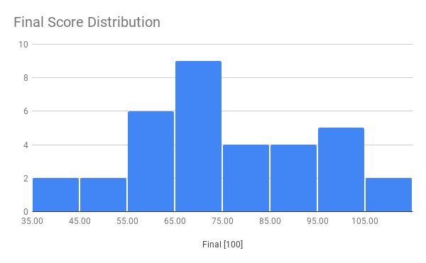
Statistics from last term: Final

Slide 31

It’s time to work hard
You must be prepared to devote >15 hours/week

Slide 32
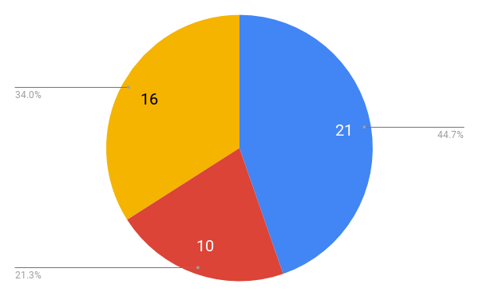
Statistics from this term: major vs. minor
CS Minor
CS Major
Undecided

Slide 33
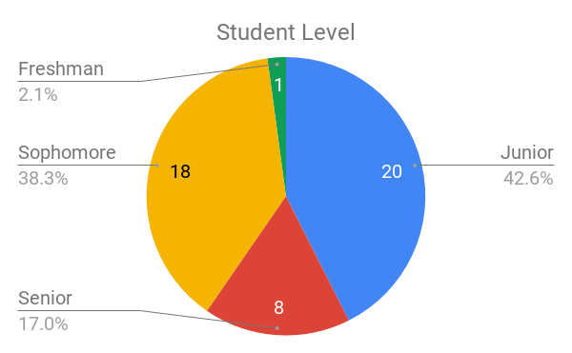



Statistics of this term:

Slide 34
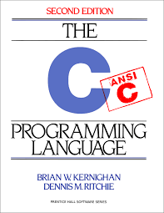
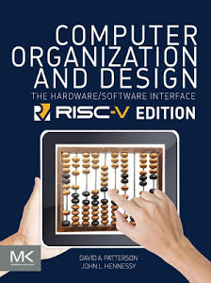
Before Class
Read the related sections in the text books
“The C Programming Language, 2nd Edition”, Prentice Hall, 1988,
Reserved at NYU library
Computer organization and design (RISC-V edition)

Slide 35
Be Active In Class
Raise your hand at any time
Ask me to repeat, repeat and repeat
Ask questions
Answer questions from me or others
Befriend your classmates and form study groups

Slide 36
After Class
Finish all labs / recitation exercises by yourself
Attend recitations
Getting help
Office hour, Piazza

Slide 37
Policies
Carnegie Mellon
You must work alone on all assignments
You may post questions on Piazza,
You are encouraged to answer others’ questions, but refrain from explicitly giving away solutions.
Labs & Exercises
Everybody has 5 grace days (incremented at half day granularity)

Slide 38
Class Info
https://nyu-cso.github.io
Recitation starts tomorrow,
bring your laptop to class

Slide 39
Integrity and Collaboration Policy
Carnegie Mellon
We will enforce the policy strictly.
The work that you turn in must be yours
You must acknowledge your influences
You must not look at, or use, solutions from prior years or the Web, or seek assistance from the Internet
You must take reasonable steps to protect your work
You must not publish your solutions
If there are inexplicable discrepancies between exam and lab performance, we will over-weight the exam and interview you.
Do not turn in labs/exercises that are not yours
You won’t fail because of one missing lab

Slide 40
Integrity and Collaboration Policy
Carnegie Mellon
We will enforce this policy strictly and report violators to the department and Dean.

